Slide 1
General Travel Training Session
Kathy Timian & Casey Avery
travel@cortland.edu
Presented 06.11.2025

Slide 2


Index
Travel Training
  Travel Authorization Request Form
  Travel Reimbursement
    Travel Voucher Tips
    Non-Employee Travel Reimbursements
  Travel Toolbox
Approvers | Conference Registration Fees | Vehicle Usage Hierarchy – Scenario 2 | Car Rentals | Day Trip Meal Reimbursement
Advances | Airline Tickets | Personal Car vs. Rental Car | Per Diem Rates | Lodging
Conference Agenda | Vehicle Usage Hierarchy – Scenario 1 | OGS Trip Calculator | Per Diem Calculator | Over-the-Max Lodging Request

Slide 3
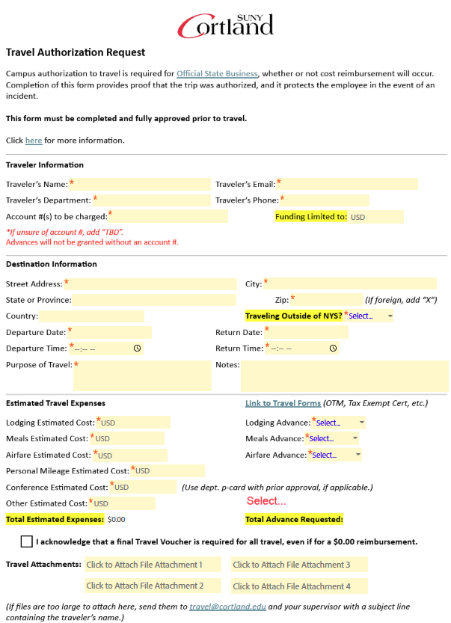
Travel Authorization
Travel Authorization Request Form
  cortland.edu/travelauth
Why do you need it?
  Campus authorization to travel is required for official State business, whether or not cost reimbursement will occur ($0.00).
  Provides proof that the trip was authorized and protects the employee in the event of an incident.
Who needs to approve it?
  Form Filler Approval Guide
  Approval Hierarchies Chart
How-to Video

Slide 4

Travel Authorization –
Form Filler Approval Guide
Form Filler Approval Guide
Participant 1 = You - the form filler (this person may also be the traveler)
Participant 2 = Traveler
Participant 3 = Traveler’s Immediate/Direct Supervisor
Participant 4 = Traveler’s Dean/AVP/Proxy
  Note: Adding Participant 4 is not needed if the traveler’s immediate supervisor is already the Dean/AVP (or higher) or their assigned proxy.
  *Division of Academic Affairs: Please check with your Dean’s AA to see if they should be added as the approver instead of the Dean.
Participant 5 = Traveler’s Provost/VP/Proxy
  Note: This is required for all out-of-NYS travel, unless the traveler’s immediate supervisor is already the Provost/VP, in which Participant 5 will be left blank, and they will be added as Participant 3.

Slide 5
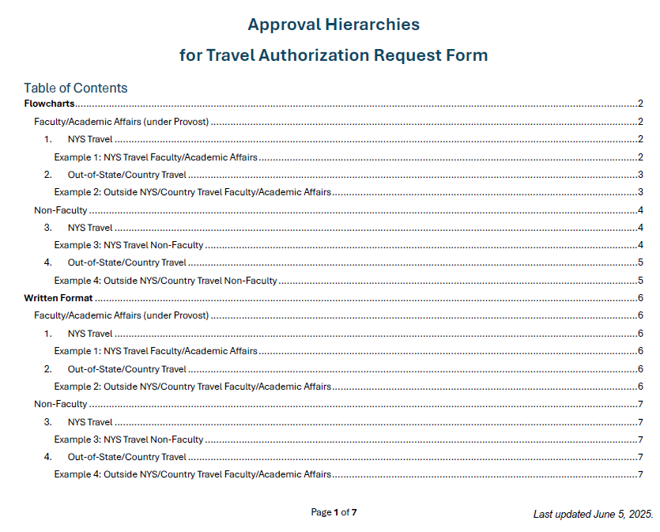

Travel Authorization –
  Approval Hierarchies
Approval Hierarchies Chart

Slide 6
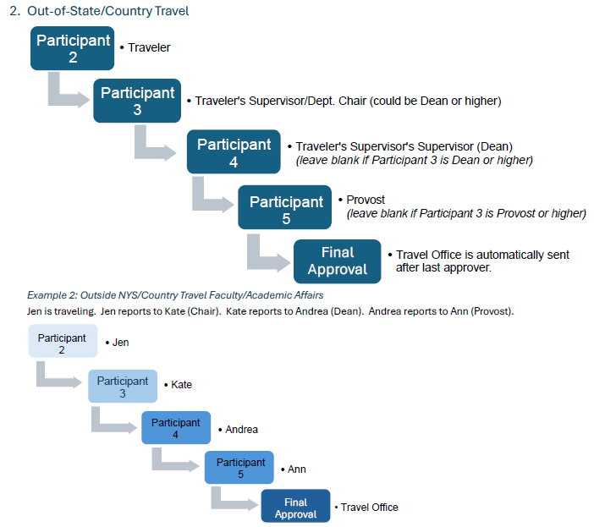
Travel Authorization –
  Approval Hierarchies
Approval Hierarchies Chart
Example - #2
Faculty – out of NYS travel

Slide 7
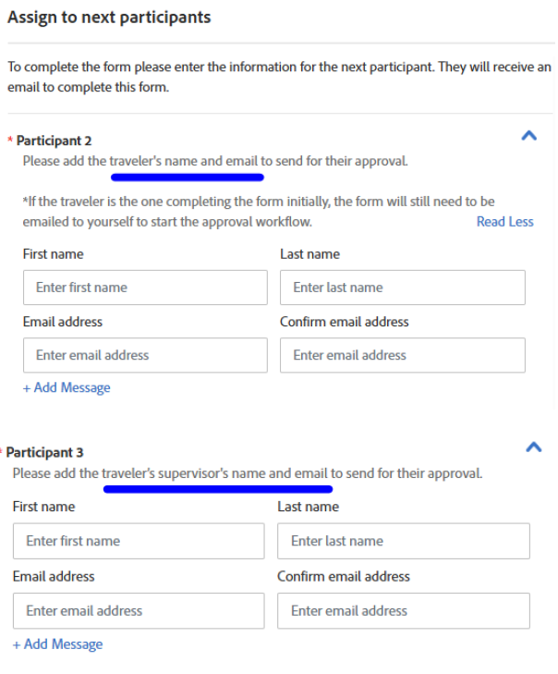
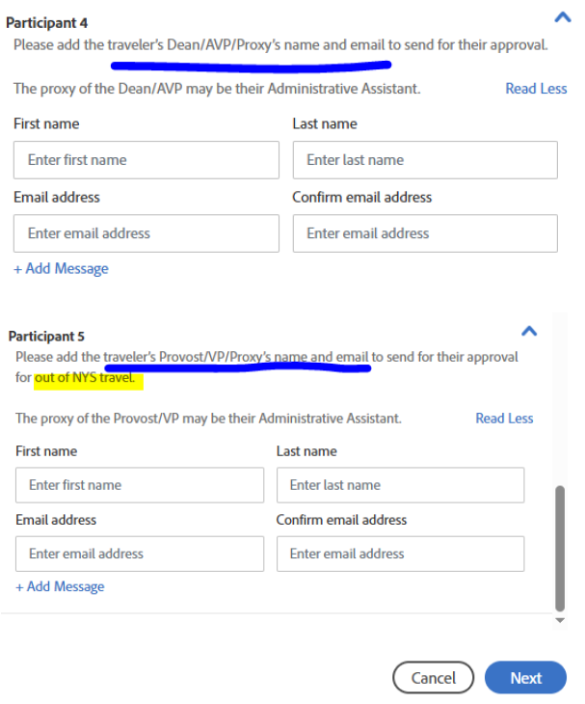
Travel Authorization –
  Approval Hierarchies
Approval Hierarchies Chart

Slide 8
Travel Authorization –
  Approval Hierarchies
Approval Hierarchies Chart
Main Take Away
Most travelers require at least 2 approvers: the traveler’s immediate supervisor and their supervisor’s supervisor. A 3rd approver may be needed when travel is out of NYS.
Only when the traveler is a Dean/AVP or higher is only one (1) approver required.

Slide 9

Travel Advances
https://www2.cortland.edu/offices/purchasing-office/travel-guidelines/#travel-advances
To cover per diem costs of meals, lodging, and/or airfare.
Must be indicated on Travel Authorization.
Should not be less than $75 or exceed funding limitations.
Issued 2 weeks prior to travel date (4 weeks for airfare).

Slide 10


Conference Agenda
Include with Travel Authorization Request
  Check online
Why do we need this?
  Meals – Verify what meals (breakfast/dinner) are included (for meal per diems).
  Dates – Confirm the dates on your travel authorization are correct.
  Location – Confirm the destination is correct on the travel authorization.

Slide 11
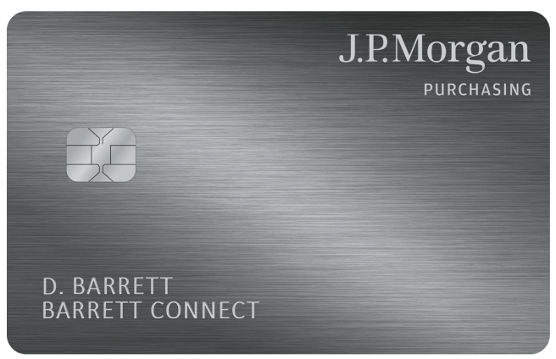
Conference Registration Fees
https://www2.cortland.edu/offices/purchasing-office/travel-guidelines/#conference-registration-fees
Use department p-card with prior approval, if applicable.
  If a credit card is not accepted, a PO should be submitted ASAP in RDD.

Slide 12
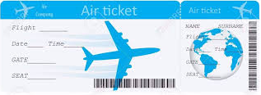
Airline Tickets
https://www2.cortland.edu/offices/purchasing-office/travel-guidelines/#airline-ticket-purchases
Check multiple airlines for best possible pricing.
The State will not pay for any extra services (i.e., seat upgrades, priority boarding, insurance, etc.).

Slide 13
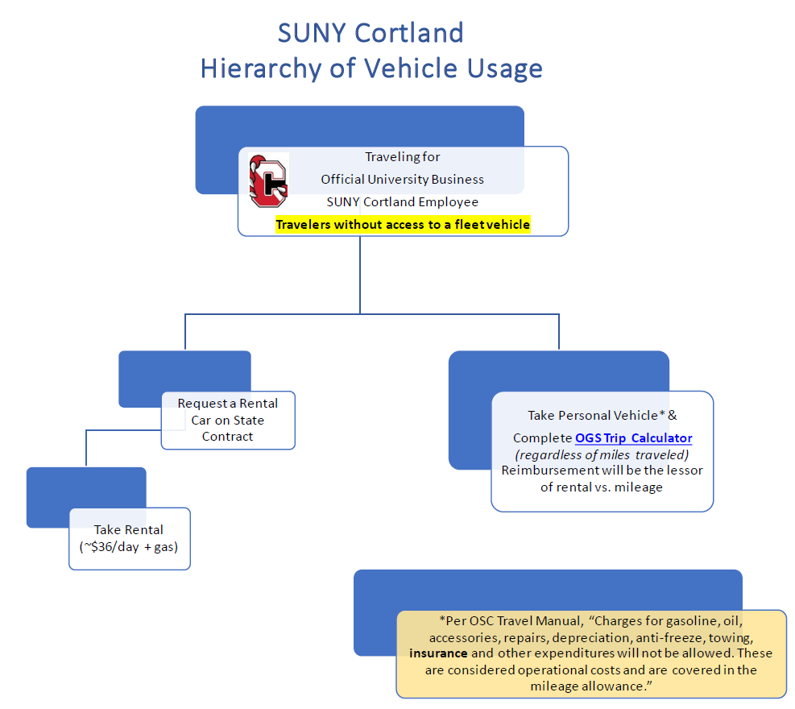
Vehicle Usage Hierarchy
Hierarchy of Vehicle Usage Flowchart
Travelers WITHOUT access to a fleet vehicle:

Slide 14
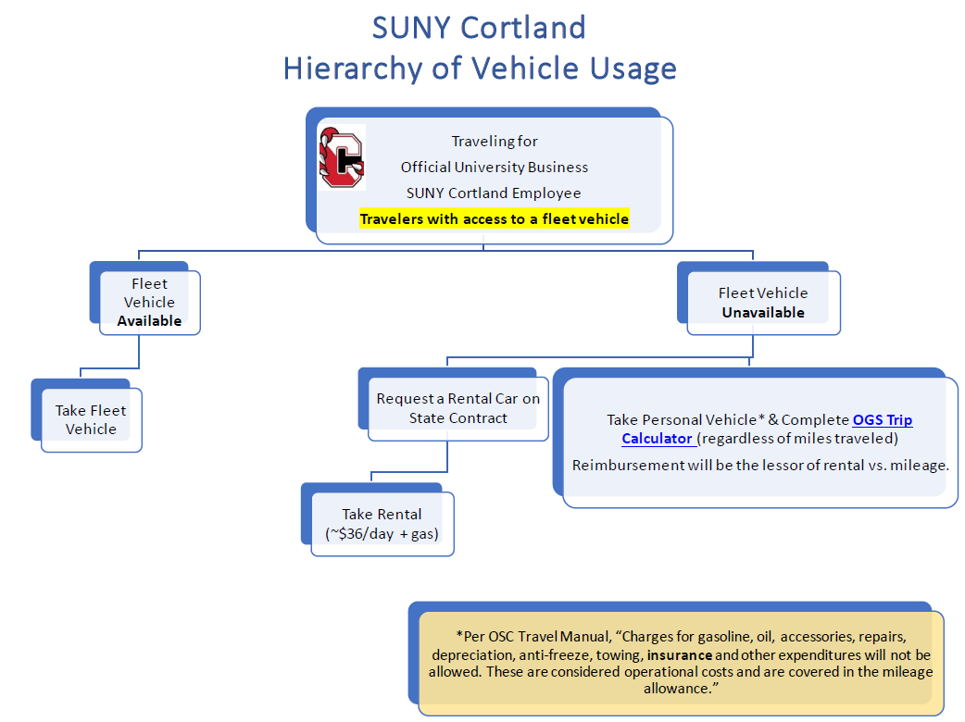

Vehicle Usage Hierarchy
Hierarchy of Vehicle Usage Flowchart
Travelers WITH access to a fleet vehicle:

Slide 15



Personal Car vs. Car Rental
Personal Car: https://www2.cortland.edu/offices/purchasing-office/travel-guidelines/#personal-car-mileage
Refer to: Hierarchy of Vehicle Usage Flowchart
Use the OGS Trip Calculator to determine whether a personal or rental vehicle is the most economical means of ground transportation to use (reimbursement will not exceed the OGS Trip Calculator).
  If using personal vehicle, attach OGS Trip Calculator to Travel Reimbursement Voucher.
OGS Trip Calculator How-to Video

Slide 16
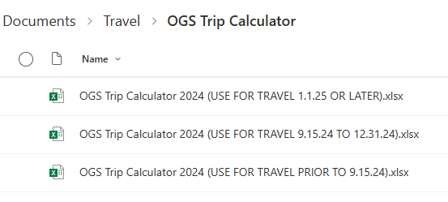
OGS Trip Calculator
OGS Trip Calculator
How-to Video

Slide 17
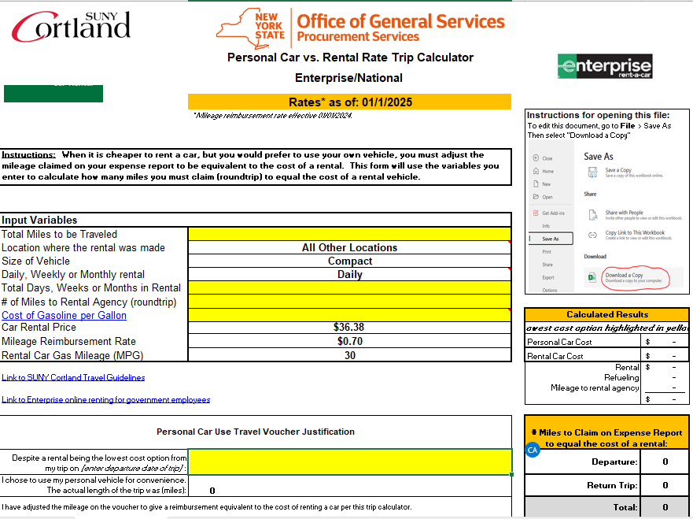

OGS Trip Calculator
OGS Trip Calculator
How-to Video

Slide 18
Car Rentals
https://www2.cortland.edu/offices/purchasing-office/travel-guidelines/#car-rentals
Hierarchy of Vehicle Usage Flowchart
Car rentals should only be made for SUNY Cortland employees.
  Not job candidates, campus guests, or students.
What you need to know when renting:
  Always rent under the NYS Contract by utilizing the SUNY Cortland account.
  No additional insurance should be purchased when renting vehicles.
  Rentals should be Compact/Economy size
    If Standard/Intermediate/Full-size are used, written justification must be provided with invoice/PO.
    If you feel that you need a larger vehicle than those mentioned above (due to multiple passengers, etc.), contact the Travel Administrator at x2306 for prior approval and include justification.
  Charges & Violations
    Operator is personally responsible for payment.
  E-ZPass Tolls
    Pay with dept. p-card.
  Gasoline Purchases
    Reimbursed with receipt(s).
    If Traveler elects to have Enterprise refuel the vehicle upon return, it will come at a premium cost to their department's budget.
Enterprise Rental Checklist
Hertz rentals are made by Travel Administrator – call x 2306 to book.

Slide 19
Per Diem Rates
https://www2.cortland.edu/offices/purchasing-office/travel-guidelines/#travel-per-diem-rates
Per Diem Rate Calculator
Search rates within the continental US
Lodging & meal allowances are calculated based on location
Lodging
Use month of stay
Meals
Use M&IE Total column amount
  SUNY Cortland uses an 80/20 breakdown for dinner & breakfast
    Example:
      $74 M&IE Total
        Breakfast = $15.00 (20%)
        Dinner = $59.00 (80%)
        Breakfast on day 1 only if traveler leaves at/before 7:00 AM
        Dinner on last day only if traveler returns at/after 7:00 PM

Slide 20
Per Diem Rate Calculator
Per Diem Rate Calculator
Scenario:
Conference starts at 8:00 AM on 6/24/25, but leaving the night before at 5:00 PM. - Entitled to dinner on 6/23/25 because now in Overnight Travel Status.
Breakfast is provided by the conference each day (6/24-6/26) - $0 given
Dinner is only provided on the 1st night of conference (6/24/25), so $0 that day for dinner.
Conference ends at noon on 6/26/25, return home by 4:00 PM – not entitled to dinner on 6/26/25.
Total meal per diem available = $138.00

Slide 21

Day Trip Meal Reimbursement
https://www2.cortland.edu/offices/purchasing-office/travel-guidelines/#day-trip-meal-reimbursement
Criteria:
  Trips one day or less, but more than 35 miles from Official Station.
  Determined by departure & return times
    Leave at or before 7:00 AM – eligible for Breakfast
      Breakfast = $5.00*
    Return at or after 7:00 PM – eligible for Dinner
      Dinner = $12.00*
    (Lunch is never reimbursed)
  Day trip meal reimbursements are reportable as income to the IRS and are subject to withholding taxes.
    *Rates subject to change.

Slide 22

Lodging
https://www2.cortland.edu/offices/purchasing-office/travel-guidelines/#hotel-reservations
Request “State/Government Rate”
  If hotel in NYS, advise we are Sales Tax Exempt, and a Tax Exemption Certificate should be provided at check-in.
Check lodging per diem rates
  If the hotel costs more than the per diem rate allowed for that location, an Over-the-Max Request must be submitted prior to booking hotel.
Obtain itemized receipt upon checkout.
  Using third-party sites like Expedia, Travelocity, etc.?
    Log into your account and get itemized invoice.

Slide 23

Over-the-Max Lodging Request
https://www2.cortland.edu/offices/purchasing-office/travel-guidelines/#over-the-max-lodging-requests
Approval must be obtained prior to booking the hotel room.
  Failure to do so may result in limited or denial of reimbursement.
Requestor will receive a final approved version – that is your “OK” to book.

Slide 24

Travel Reimbursement
https://www2.cortland.edu/offices/purchasing-office/travel-guidelines/#travel-reimbursement
Travel Voucher (AC132)
Per NYS, within 30 days of returning from their trip, the traveler must submit a travel voucher packet, containing the voucher and any supporting documentation.
Upon return from trip
  Complete Travel Voucher (AC132) (whether requesting reimbursement or not ($0.00))
    Attach all receipts (lodging, tolls, parking, registration fees, etc.)
      Not meal receipts if using unreceipted method
    If conference, include conference agenda
    For mileage or rental car gasoline reimbursement, complete the Statement of Automobile Travel (Form AC 160)
    Traveler signs voucher
    Traveler’s supervisor signs voucher
      Academic Affairs – check with your Dean to see if they need
      to sign too (we don’t require it).
    Add Account # (bottom left)

Slide 25
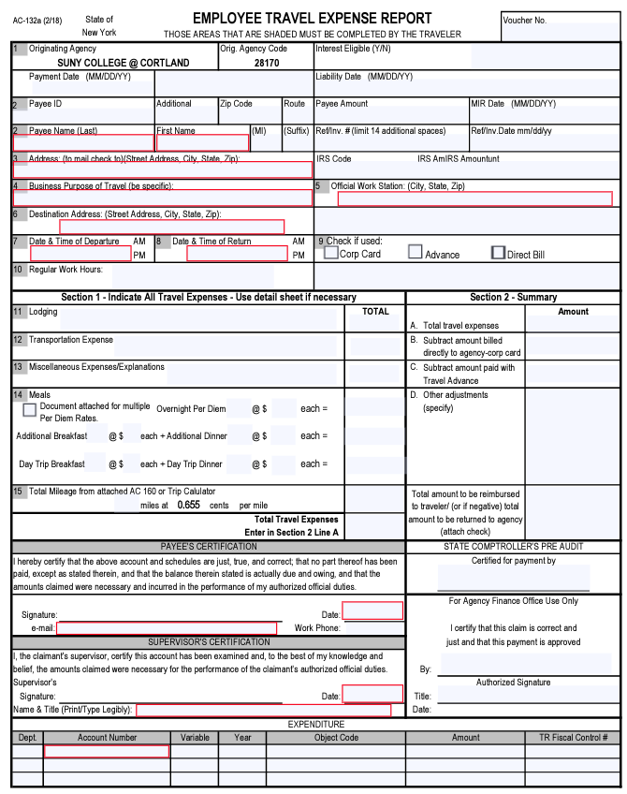
Travel Voucher Tips
Top Portion of Travel Voucher
  Do not add employee ID # or SSN to voucher.
  Include traveler’s home address (not SUNY Cortland)
  Business Purpose = Name of Conference, Meeting, etc. (not “Travel”)
  Include full address of destination (Street, City, State, & Zip)
  Dates and times of departure and return
Section 1
  Complete all applicable fields with descriptions & amounts
  Any missing receipt, please include a missing receipt affidavit
Section 2 – Summary
  Total from left side
  Total paid with p-card (ex. conference fees)
  Travel Advance Amt
  Other adjustments (ex. grant funding)
  Grand Total of Reimbursement
Payee Certification
  Traveler signs (no digital or electronic signatures), date, email
Supervisor’s Certification
  Traveler signs (no digital or electronic signatures), date, email
Account Number
  Account # to charge
Reimbursements will be sent back if not fully completed.
Email: travel@cortland.edu
1
2
3
4
5
6

Slide 26
Non-Employee Travel Reimbursement
https://www2.cortland.edu/offices/purchasing-office/travel-guidelines/#job-candidates
Job Candidates*
Travel expenses allowed to persons residing more than 50 miles from interview site (i.e., campus)
  Pay upfront and then reimbursed
    Standard Voucher & Itemized receipts
https://www2.cortland.edu/offices/purchasing-office/speaker-contracts
Speaker/Campus Guests
Only available to reimburse travel expenses with a fully executed agreement in place (signed by Purchasing & Accounts Payable office prior to the event).
  Terms of reimbursement will be called out in contract.
  Lodging
    Local hotel reserved by Dept/Office AA, under guest’s name
      Fairfield, Ramada, & Quality Inn will all bill the university directly.
        PO put in RDD after stay (AP will email invoice to AA)
  Meals**
    For no more than the campus guest plus two (2) University members.
        Breakfast = max $13/person
        Lunch = max $18/person
        Dinner = max $35/person
  **Rates subject to change.
*Division of Academic Affairs – see Faculty/Staff Candidate Search Guidelines

Slide 27
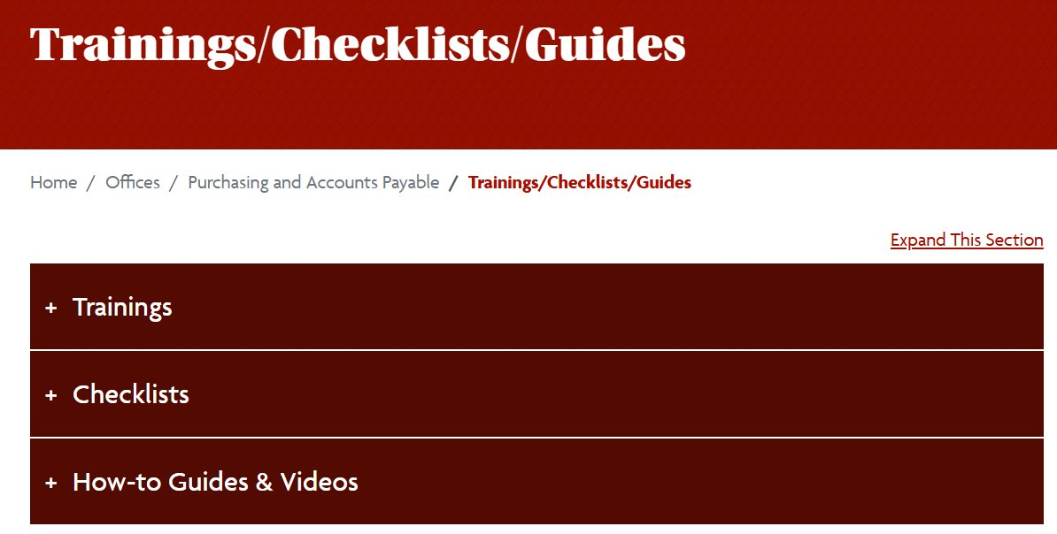



Travel Toolbox
https://www2.cortland.edu/offices/purchasing-office/purchasing-trainings_checklists_guides
Travel Forms: https://www2.cortland.edu/offices/purchasing-office/purchasing-forms.dot#travel
Travel Guidelines: https://www2.cortland.edu/offices/purchasing-office/travel-guidelines/

Slide 28

Contacts
Kathy Timian
Travel Administrator
x2306
kathy.timian@cortland.edu
Casey Avery
Associate Director of Purchasing & AP
x2307
casey.avery@cortland.edu
Travel Email: travel@cortland.edu
Travel Website: https://www2.cortland.edu/offices/purchasing-office/travel-guidelines/

Slide 29

Why are we asking for this?

